Slide 1
CASA
Project Pitch – BBY31

Slide 2
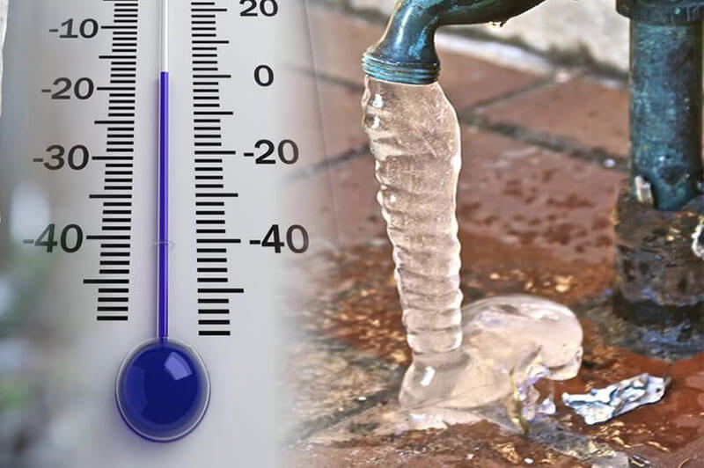
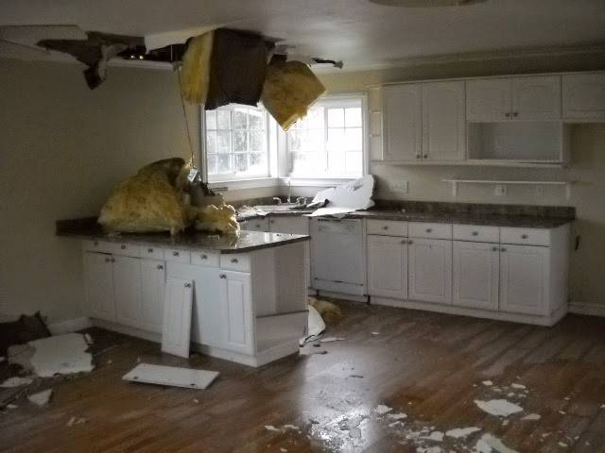
https://www.unitedstatesbd.com/images/unitedstatesbdcom/bizcategories/13680/image/frozen-burst-pipe-repair.jpg
https://d31029zd06w0t6.cloudfront.net/wp-content/uploads/sites/38/2019/01/web1_frozen-pipes.jpg
Notes:
When was the last time a pipe burst in your home because you forgot to turn off the pipes before winter?

Slide 3
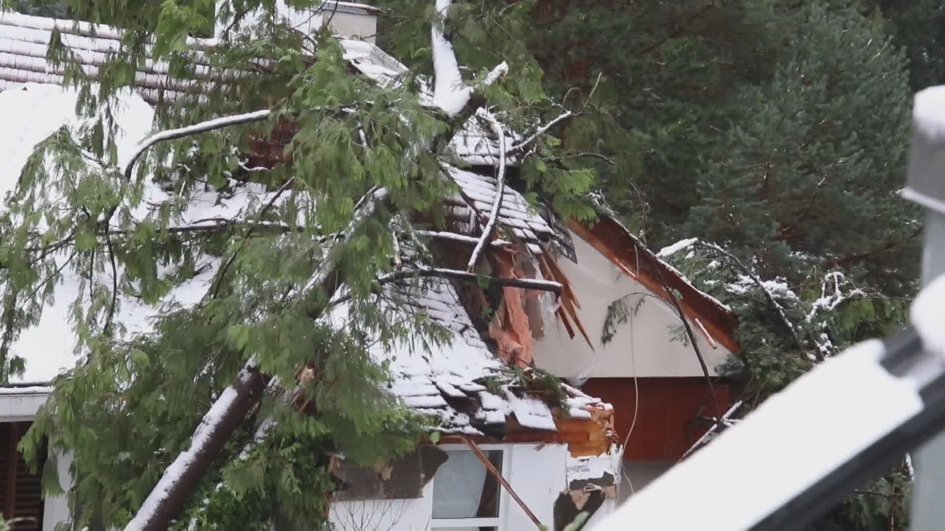
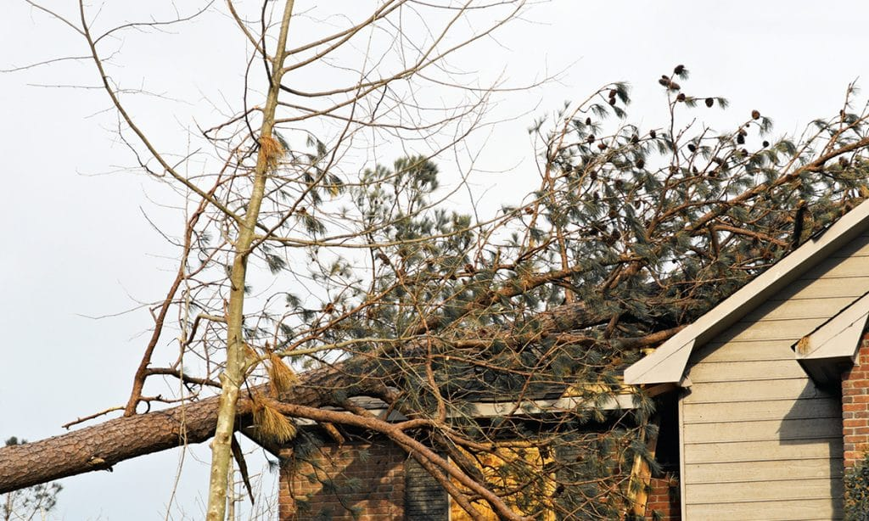
https://media.globalnews.ca/videostatic/news/amzkbxgr0t-307v0unvxe/6P_FATAL_WEATHER_TREE.jpg
https://directroofing.ca/wp-content/uploads/2020/03/tornado-damaged-house-with-a-pine-tree-on-the-roof-1024x614.jpg
Notes:
Or had a tree branch break off during a storm and damage your roof?

Slide 4
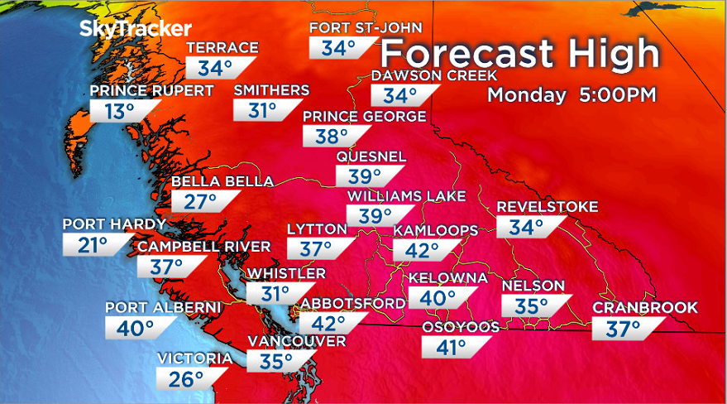

https://globalnews.ca/wp-content/uploads/2021/06/monday-forecast.png
https://cdn-res.keymedia.com/cms/images/us/036/0292_637606512336964289.jpg
Notes:
How did your family cope with the heat dome in 2021?

Slide 5
And we all live in Vancouver and have our own stories of suffering weather related damages to our home. But that doesn’t have to be you!

Slide 6


Introducing Casa!
Our team is working hard to bring you an app that gives you the tips you need to keep your house safe from our changing weather and makes it easy to find local services to give you a hand.

Slide 7


Think of us as Uber for your house!

Slide 8
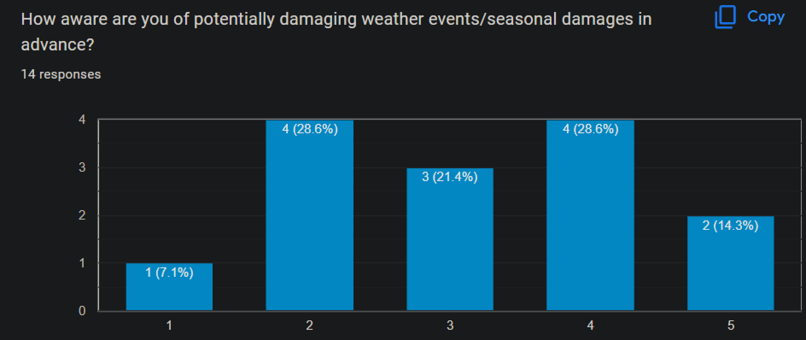
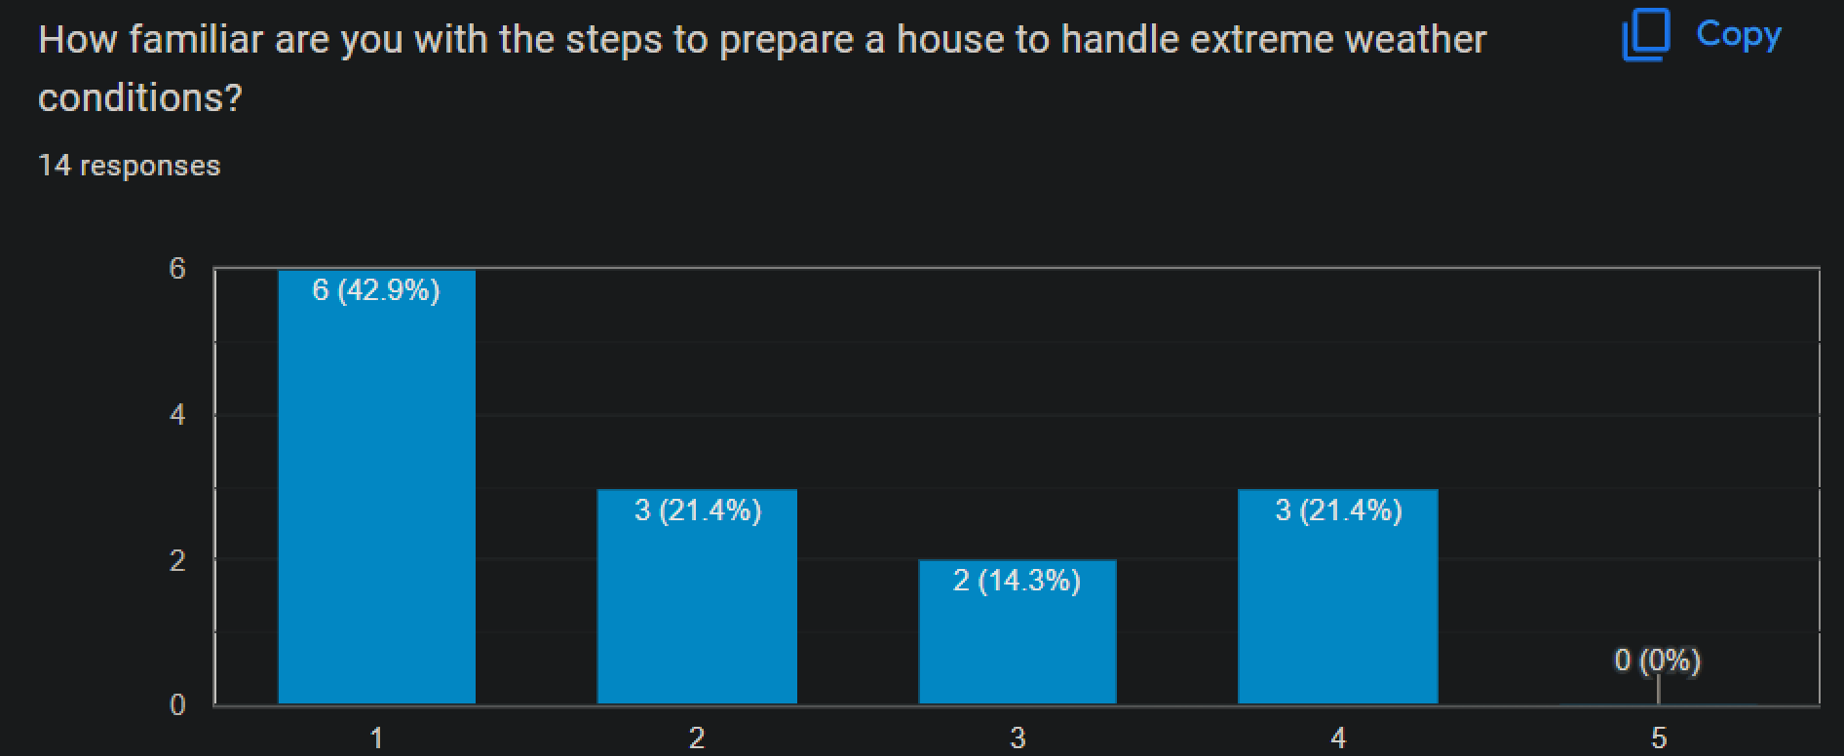
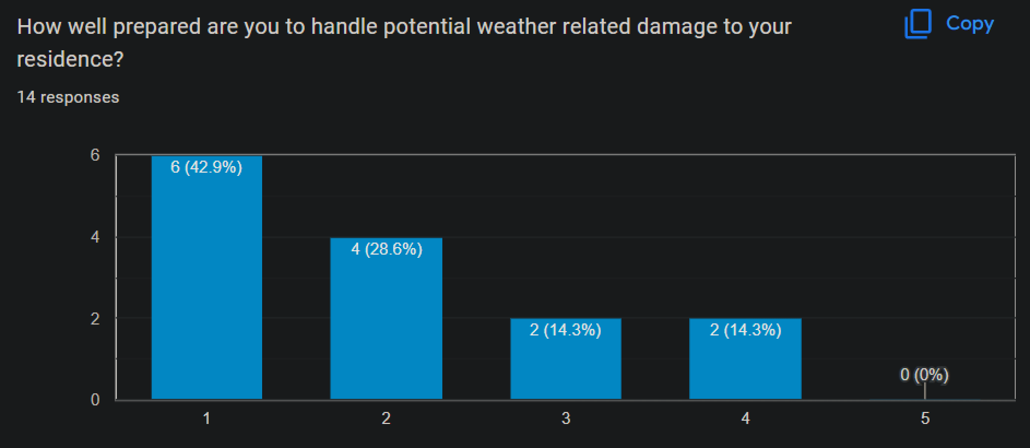
Our research has found that over 2/3 of you feel you don’t know enough about how to prepare for and handle damages to your home caused by weather.

Slide 9
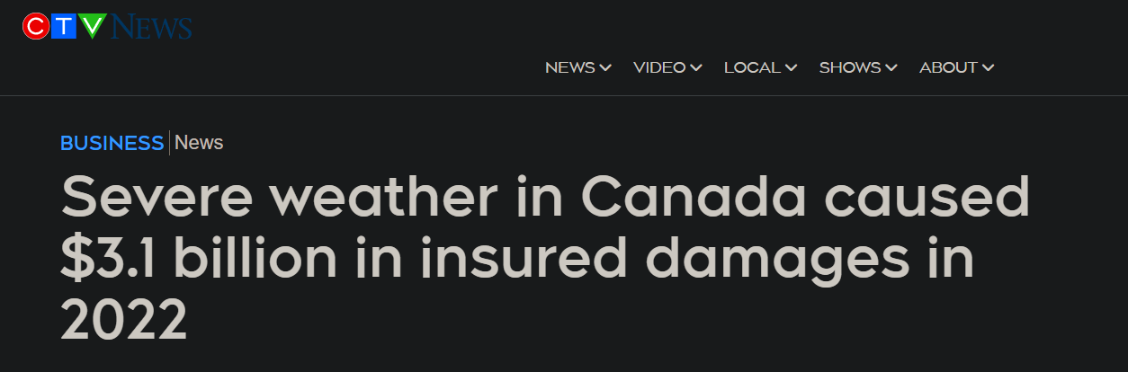
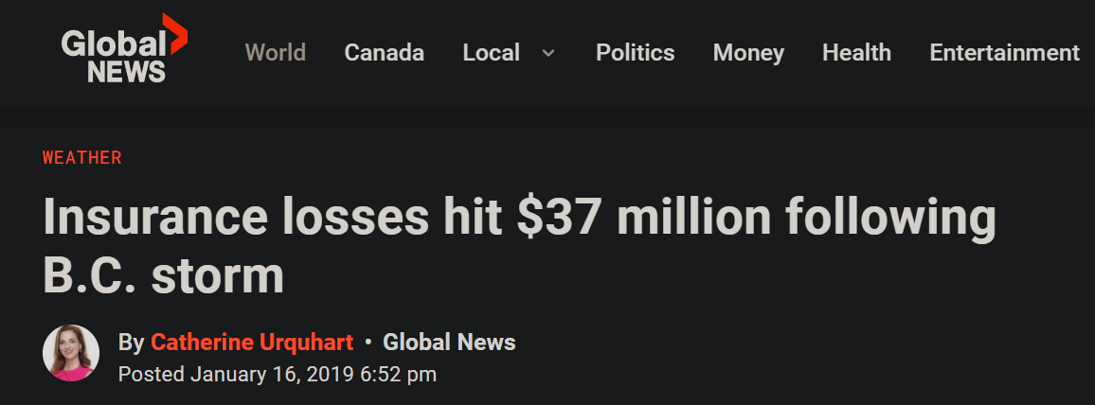
Fixing damage is expensive. Last year extreme weather cost Canadians over 3 billion dollars! Fortunately you can minimize your own risk by taking steps at the right time before they happen.
https://www.ctvnews.ca/business/severe-weather-in-canada-caused-3-1-billion-in-insured-damages-in-2022-1.6237455#:~:text=The%20Insurance%20Bureau%20of%20Canada,insured%20losses%20in%20Canadian%20history.

Slide 10
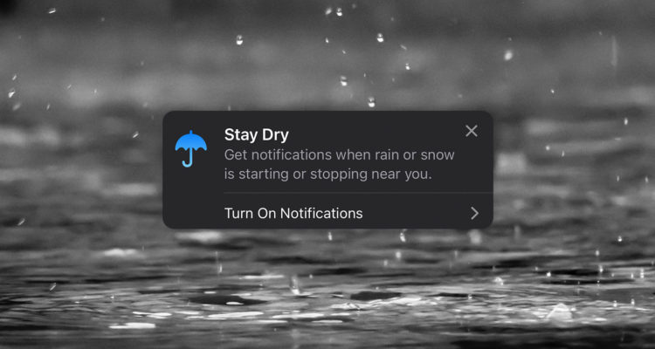
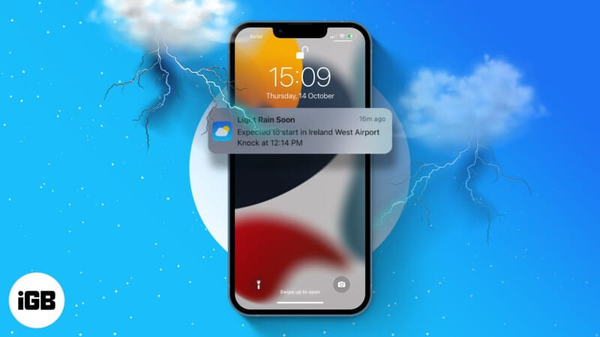
https://www.igeeksblog.com/wp-content/uploads/2020/04/How-to-get-Weather-notification-on-iPhone-and-iPad-800x450.jpg
Where do you begin? Once you download Casa, you’ll start receiving notifications before extreme weather events like heavy storms, and seasonally before summer and winter. These notifications will provide you with quick tips to take before the weather starts to change.
https://www.tapsmart.com/wp-content/uploads/2021/10/rain-notifications-weather-750x400.jpg

Slide 11
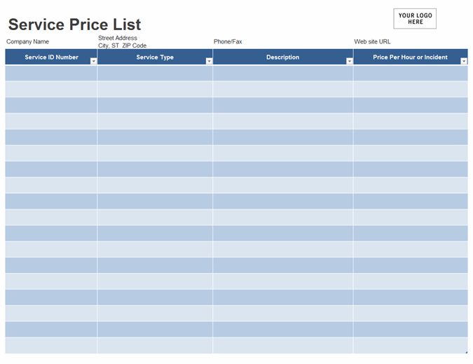

Now what if you’re not so handy around tools? Can’t find the ladder in garage? Got a bad back? No worries! When you receive one of our notifications, you’ll also find a linked list of local services that can help do the job for you. Sounds simple right?
https://media.istockphoto.com/id/911321606/vector/man-with-blank-service-list-businessman-hold-checklist-vector-illustration.jpg?s=170667a&w=0&k=20&c=xNj8QtkpzCvJ2xalhQO9mvP2uw5WDeUlQsU6XK0lMGw=
https://binaries.templates.cdn.office.net/support/templates/en-us/lt02809122_quantized.png

Slide 12
You see we’re more than just Google or your local weather report. Casa will save you time and headache and get things moving faster.

Slide 13
Damage already happen? What do you do? Check Kijiji? Craigslist? The Yellowbook? Pfff of course not! On Casa you’ll also find a list of local services and for your repair needs as well.

Slide 14
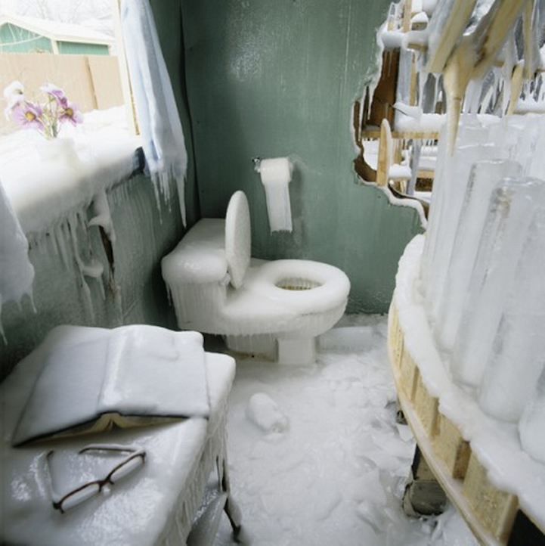
Hey! Do you know how much heat can escape from an incomplete door seal? Think about all those extra dollars you’re wasting on BC Hydro bills!
https://mymodernmet.com/wp/wp-content/uploads/archive/4-E9TtNnQvzGl9TXodUg_1082102397.jpeg

Slide 15
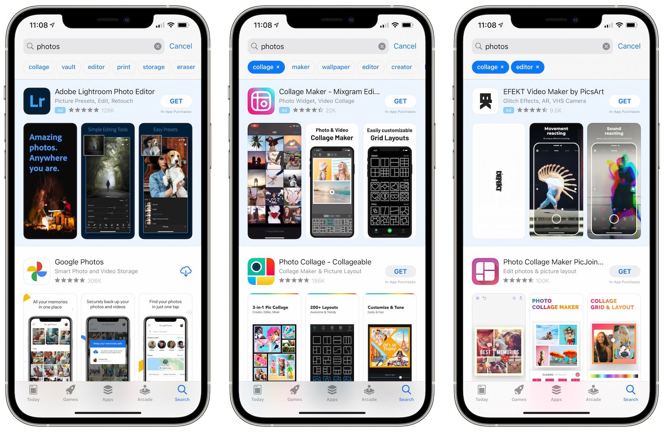

https://images.macrumors.com/t/sV3C_6KQaRKvoB0K3yfEddosdf0=/1600x/article-new/2021/04/app-store-search-tags.jpg
Every year winter and summer arrive and can surprise you if you’re not paying attention. Just install the app and we’ll remind you when you forget.
Casa! Lookout for it on the Apple and Play Store soon!
https://theplatformlaw.files.wordpress.com/2021/08/5297951-7905525.jpg

